Slide 1


Monitoring Risks
and
Identifying Fraud
Within New York State Agencies
Presented By:
Katie Q. McCutcheon
Deputy Chief Counsel
Director of Training
Erin Bach
Confidential Investigator
Internal Controls Officer
Katherine Rizzo
Senior Investigative Auditor
New York State Internal Controls Association
March 2025
For Educational Purposes Only

Slide 2
Road Map For The Day
Purpose # 1
Introduce you to the Offices of the New York State Inspector General Lucy Lang.
Purpose # 2
Discuss the foundational concepts of internal controls.
Purpose # 3
Review OIG workers’ compensation fraud case examples that have internal control implications.

Slide 3
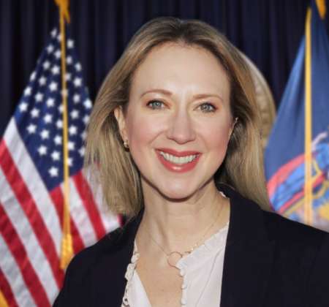
New York State
Inspector General
Lucy Lang
      Appointed by Governor Kathy Hochul as State Inspector General on November 29, 2021.
      Committed to Transparency and Accountability.
      Previously served as Director of the Institute for Innovation in Prosecution, CUNY John Jay College.
      Former Assistant District Attorney in the Manhattan District Attorney's Office.

Slide 4


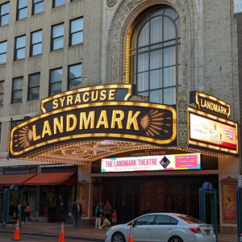

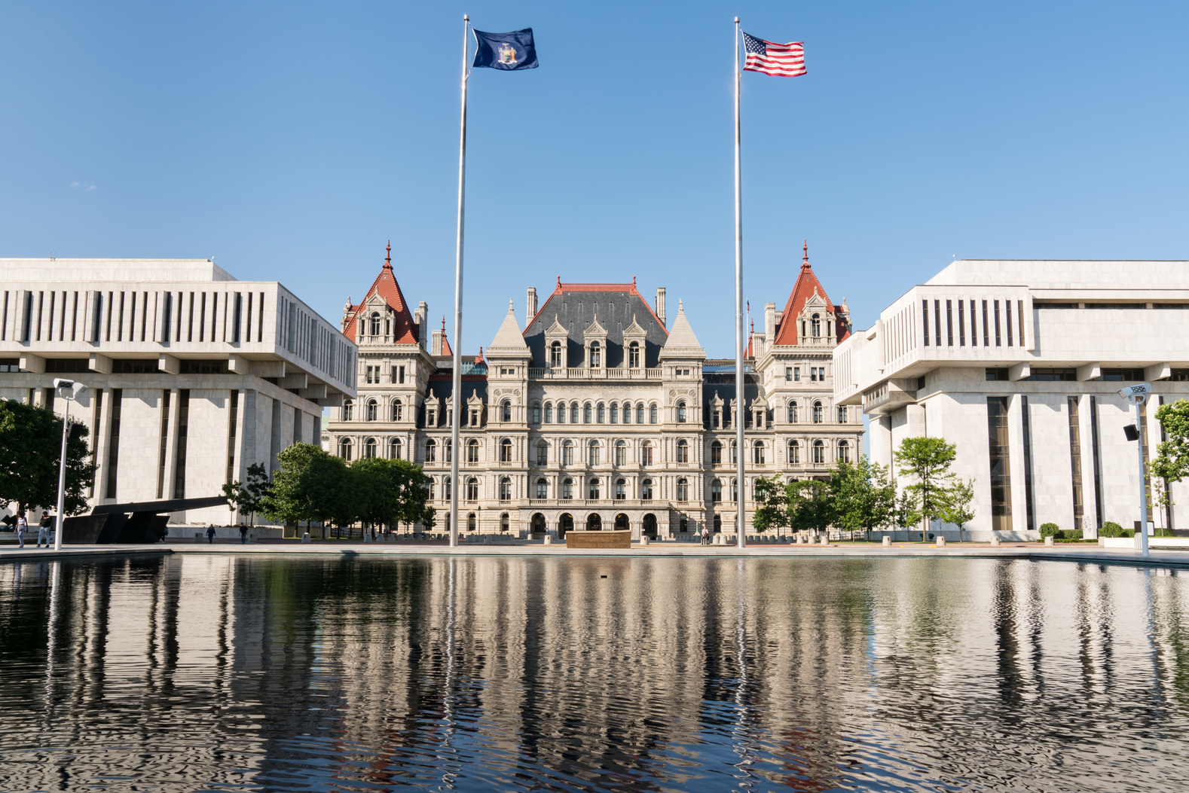





Western Region
Offices of the Inspector General
Statewide Presence
Upstate Region
Comprised of trained investigators, experienced attorneys, and skilled forensic auditors and analysists, our professional staff possess a broad range of expertise and is dedicated to working to combat corruption in state government.
New York City Region
Long Island Region

Slide 5



Offices of the New York State Inspector General
Office of the New York State Inspector General
Office of the New York State Welfare Inspector General
Office of the New York State Workers’ Compensation Fraud Inspector General

Slide 6
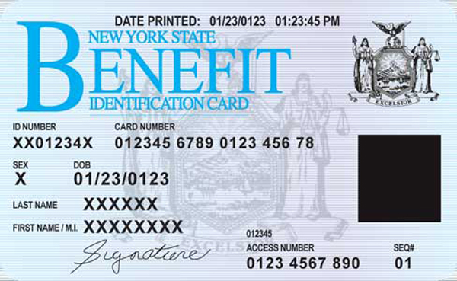
Office of the Welfare Fraud Inspector General
  Tasked with maintaining the integrity of New York State's public assistance programs.
  Conducts investigations of fraud, abuse and illegal acts perpetrated within local social services districts and by beneficiaries of public assistance services.
  Establishes initiatives aimed at the early detection and prevention of fraud.

Slide 7
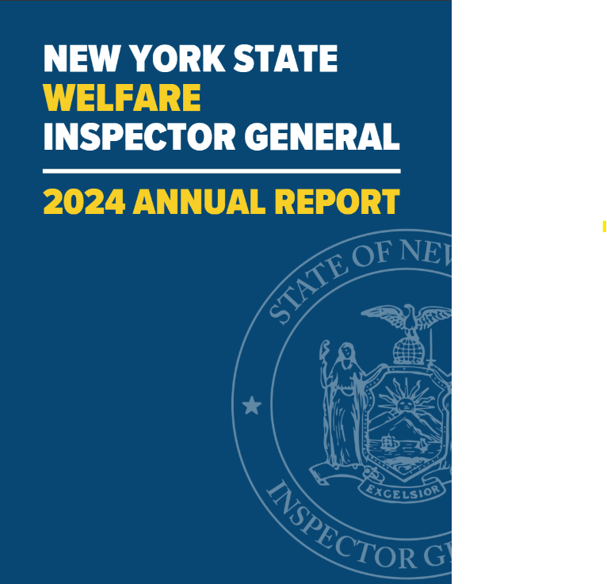
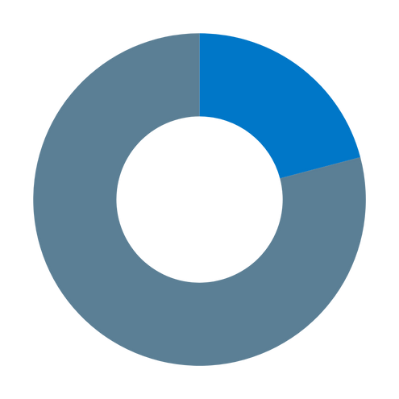

Allegations of Fraud
(20.9%)
990
COMPLAINTS
Requests for Assistance
(79.1%)
Prosecutions of OWIG cases in 2024 led to almost $600,000 in court-ordered restitution, including:
$140,528 of stolen public assistance funds,
$72,459 to the U.S. Social Security Administration, and
$381,815 of unemployment insurance benefits.
Source: https://ig.ny.gov/news/welfare-inspector-general-releases-2024-annual-report

Slide 8

Office of the Workers' Compensation Fraud Inspector General
  Workers' Compensation Law § 136
  Responsible for investigating violations of the laws and regulations pertaining to the operation of the workers' compensation system.
  WCFIG's investigations include Claimant Fraud, Employer Fraud, and Provider/Professional Fraud.
  WCFIG also provides investigatory oversight of the State's Paid Family Leave program.
Example:
  DOT vehicle safety employee defrauded the WC system by claiming injury and then secretly operating his own trucking company.
  Vehicle had multiple safety violation.
  Used his State position to illegally access sensitive driver information and violation information to get an unfair advantage.
  Plead guilty to Attempted Offering False Instrument for Filing, $28,580 restitution to DOT, resignation from DOT.
NYS Workers’ Compensation Law 136

Slide 9


Jurisdiction
The New York State Inspector General has authority over all executive branch agencies, departments, divisions, officers, boards and commissions, and certain public authorities and public benefit corporations, the heads of which are appointed by the governor, and which do not have their own inspector general by statute.
NYS Executive Law Article 4-A

Slide 10
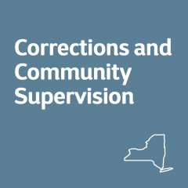

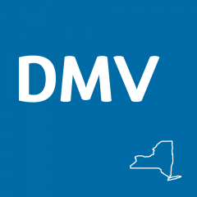
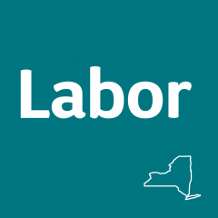




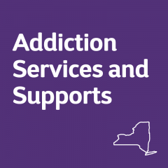



Which Agencies?
And many more...

Slide 11

New York State Executive Law Article 4-A
Mandatory Reporting Obligations - Executive Law 55
ALL New York State officers and employees in a covered agency shall promptly report to the state inspector general any information concerning corruption, fraud, criminal activity, conflicts of interest or abuse by another state officer or employee relating to his or her office or employment, or by a person having business dealings with a covered agency relating to those dealings.
The knowing failure of any state employee/officer to report shall be cause for removal from office or employment.
Any officer or employee who acts pursuant to this subdivision....shall not be subject to dismissal, discipline or other adverse personnel action.

Slide 12
New York State Executive Law Article 4-A
Investigative Powers of NYSIG - Executive Law 55
notwithstanding any law to the contrary, examine and copy or remove documents or records of any kind prepared, maintained or held by any covered agency;
require any officer or employee in a covered agency to answer questions concerning any matter related to the performance of his or her official duties;
subpoena and enforce the attendance of witnesses;
administer oaths or affirmations and examine witnesses under oath;
require the production of any books and papers deemed relevant or material to any investigation, examination or review;

Slide 13




New York State Executive Law Article 4-A
Responsibilities of NYSIG Under Section 53
Investigate allegations of corruption, fraud, criminal activity, conflicts of interest, or abuse.
Develop Training programs for state officers & employees on the prevention and elimination of corruption, fraud, criminal activity, conflicts, or abuse in covered agencies.
Recommendations
to prevent or eliminate corruption, fraud, criminal activity, conflicts of interest or abuse.
Policy Review
Periodically review and examine policies and procedures of covered agencies.

Slide 14
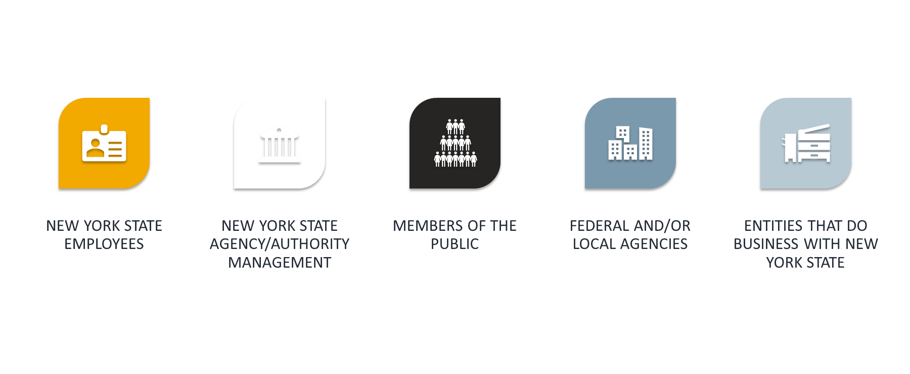
Who Makes Complaints to the Inspector General?
How Do You Make a Complaint?
1-800-DO-RIGHT (1-800-367-4448)
ig.ny.gov
@NewYorkStateIG
Inspector.General@ig.ny.gov

Slide 15


What are Internal Controls?
A process that integrates the activities, plans, attitudes, policies, systems, resources and efforts of the people of an organization working together, and that is designed to provide reasonable assurance that the organization will achieve its mission and objectives.

Slide 16
411 for New Internal Control Officers
In March 2019, NYSICA released a “411 for New Internal Control Officers”.
The function and benefits of internal controls and risk management in an organization:
Helps organizations accomplish their mission and objectives
Reduces opportunities for fraud
Prevents loss of funds or other resources
Establishes standards of performance
Ensures compliance with laws, regulations, policies and procedures
Preserves integrity
Ensures public confidence
Protects all employees

Slide 17


The COSO Five Components of Internal Control and the OIG Mission
Detect, investigate, deter, and eliminate corruption, fraud, criminal activity, conflicts of interest, and abuse in the State entities under our jurisdiction.
Monitoring
Control Activities
Information & Communication
Ensure that State officials and employees meet the highest standards of integrity, efficiency, and accountability.
Risk Assessment
Control Environment

Slide 18

Control Environment
A set of standards and processes that provide the structure for carrying out internal control across the organization.
  Demonstrates commitment to integrity and ethical values.
  Exercises oversight responsibility.
  Establishes structure, authority and responsibility.
  Demonstrates commitment to competence.
  Enforces accountability.
Monitoring
Control Activities
Information & Communication
Risk Assessment
Control Environment

Slide 19
Monitoring/Risk Assessment
Ongoing evaluations to assess whether the five components of internal controls are effectively functioning.
  Conducts ongoing and/or separate evaluations.
  Evaluates and communicates deficiencies.
Monitoring
Involves a dynamic and iterative process for identifying and analyzing risks to achieving the entity’s objectives.
Control Activities
  Specifies suitable objectives
  Identifies and analyzes risk
  Assesses fraud
  Manages risk during change
Information & Communication
Risk Assessment
Control Environment

Slide 20
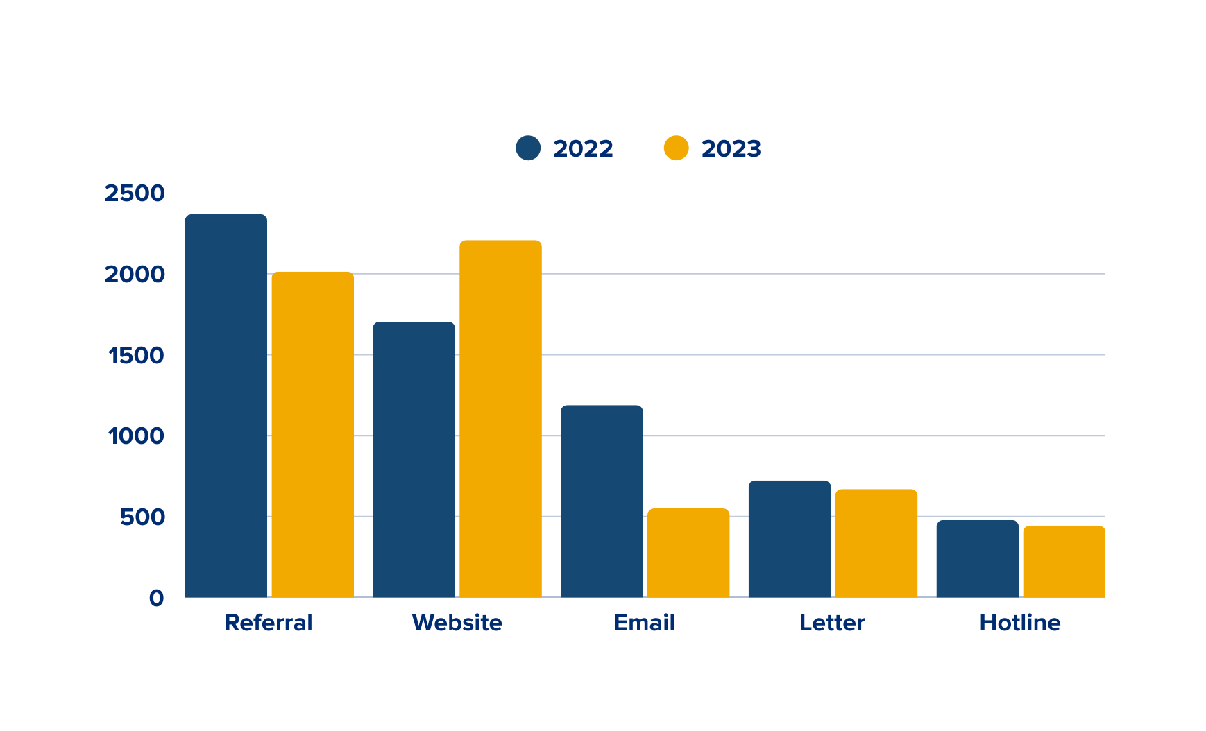

TOP 5 COMPLAINT SOURCES
A YEAR-TO-YEAR COMPARISON

Slide 21
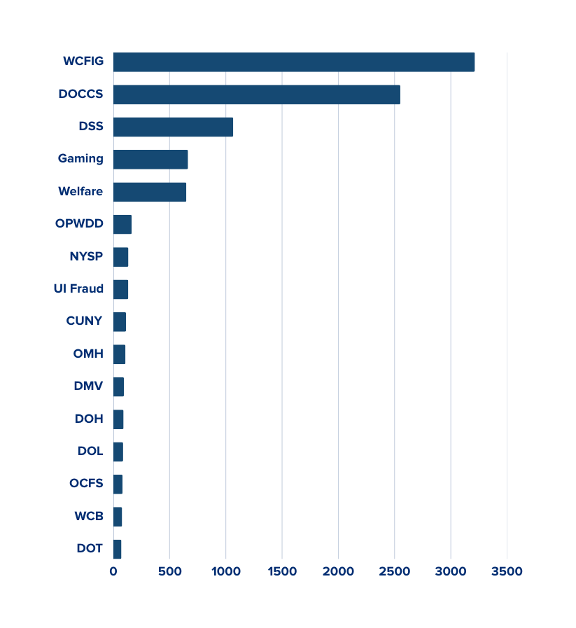
OIG: TOP COMPLAINTS BY AGENCY
12,705
Agency | 2022 | 2023 | YOY Change
Workers’ Compensation Fraud Inspector General | 1455 | 1759 | +20.89%
Department of Corrections & Community Supervision | 1507 | 1044 | -30.72%
DSS/Welfare | 378 | 688 | +82.01%
Gaming | 290 | 374 | +28.97%
Welfare | 314 | 335 | +6.69%
Office for People With Developmental Disabilities | 66 | 97 | +46.97%
New York State Police | 47 | 87 | +85.11%
Unemployment Insurance Fraud | 117 | 16 | -86.32%
City University of New York | 72 | 41 | -43.06%
Office of Mental Health | 63 | 45 | -28.57%
Department of Motor Vehicles | 49 | 45 | -8.16%
Department of Health | 48 | 43 | -10.42%
Department of Labor | 39 | 48 | +23.08%
Office of Children & Family Services | 39 | 43 | +10.26%
Workers’ Compensation Board | 35 | 43 | +22.86%
Department of Transportation | 47 | 25 | -46.81%
Total number of complaints received
by OIG between 2022 & 2023.
OIG: TOP COMPLAINTS BY AGENCY
2022 / 2023 COMBINED

Slide 22
Information & Communication
Communication should occur internally and externally to provide the agency with needed information to support its system of internal controls and to achieve its objectives.
Monitoring
  Uses relevant information
  Communicates information internally
  Communicates information externally
Control Activities
Information & Communication
Risk Assessment
Control Environment

Slide 23

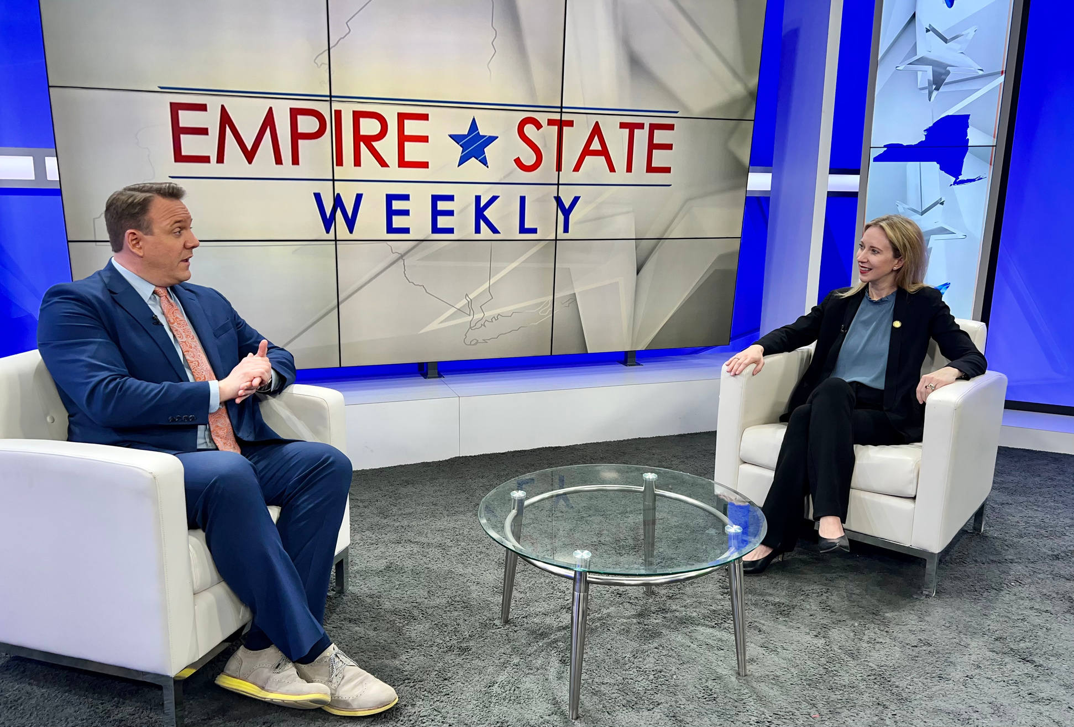
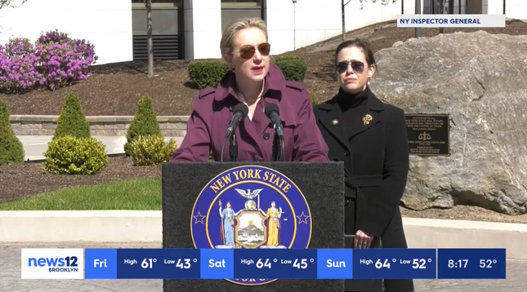
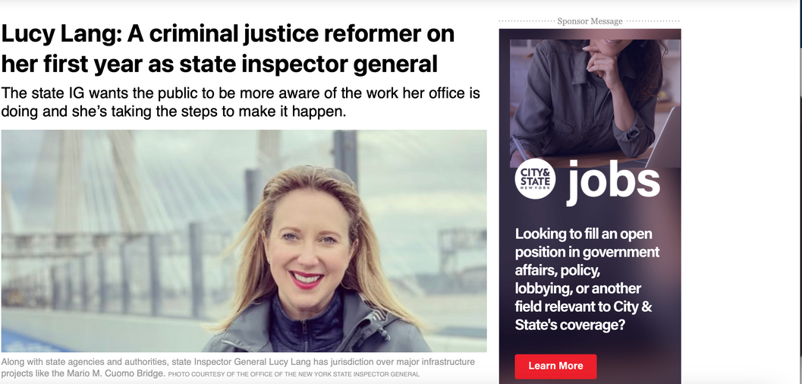
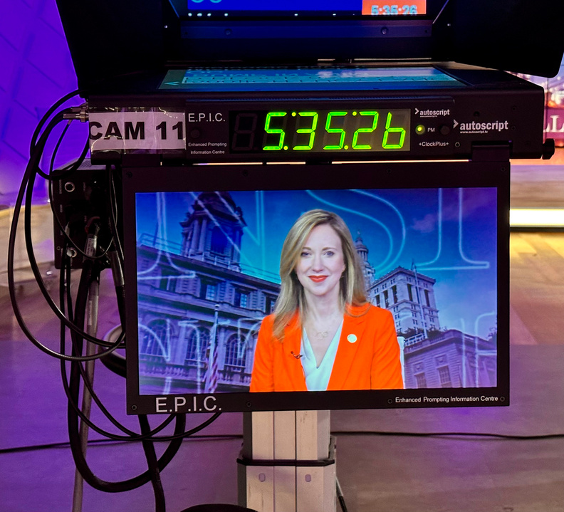

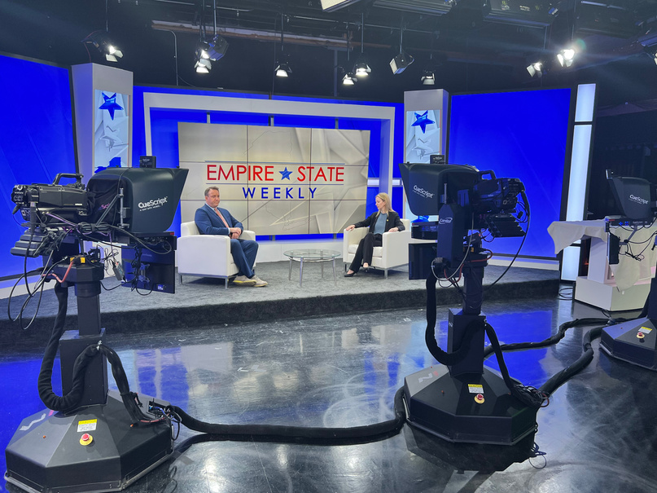
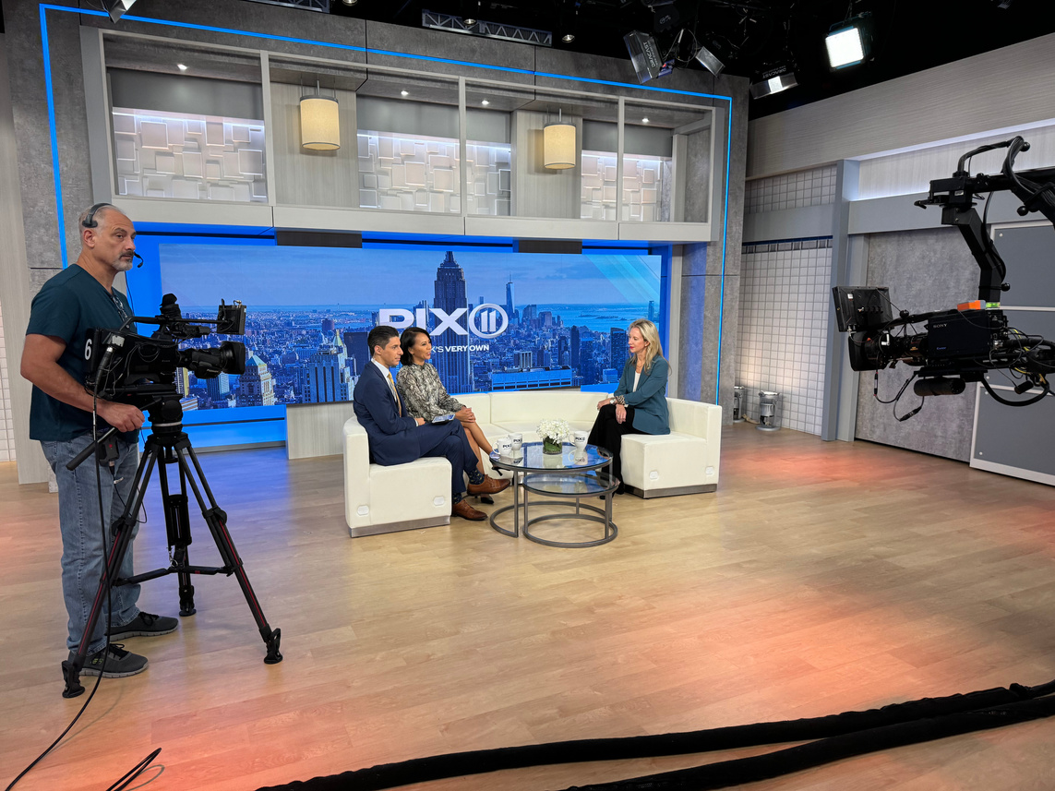



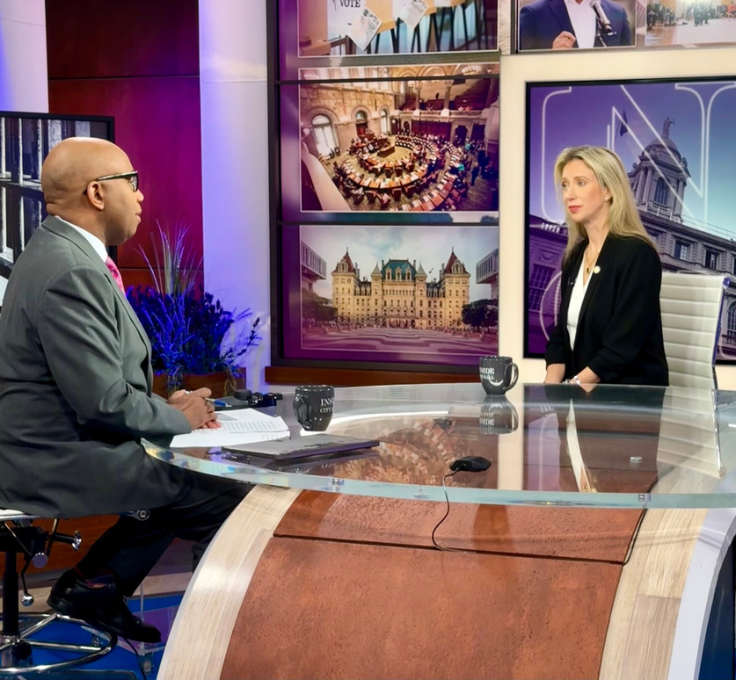
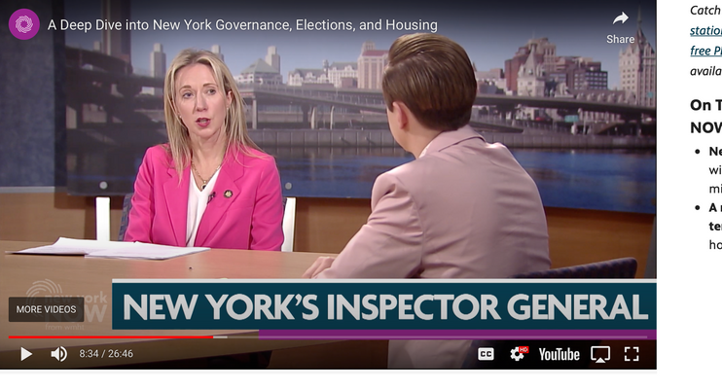
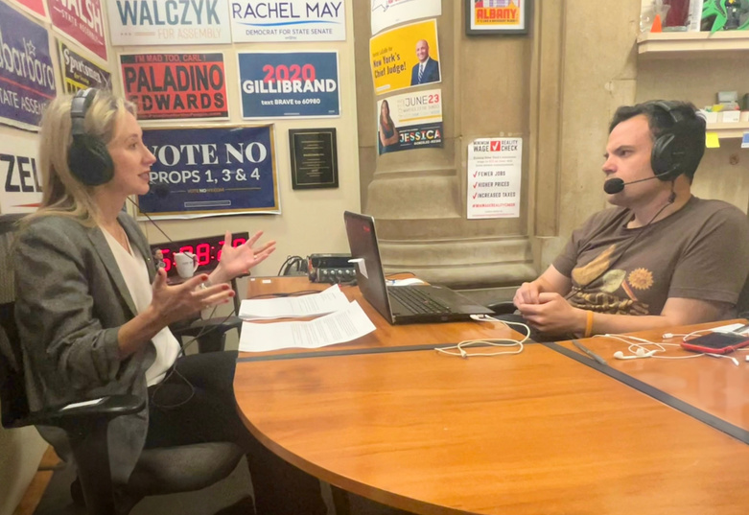
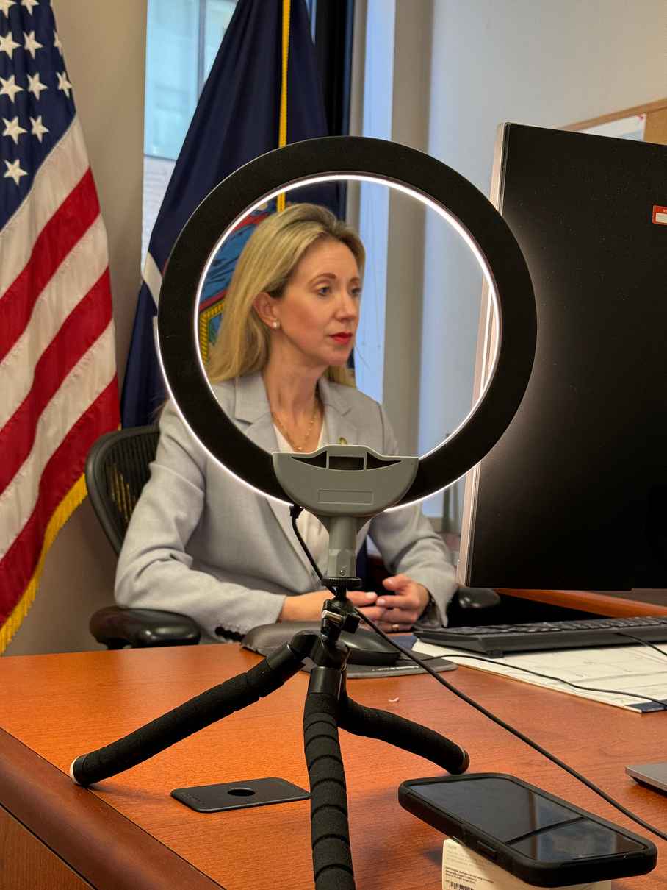
2023
Media Interviews Breakdown
28
13
5
10
Total Interviews
in 2023
Television
Print
Radio

Slide 24
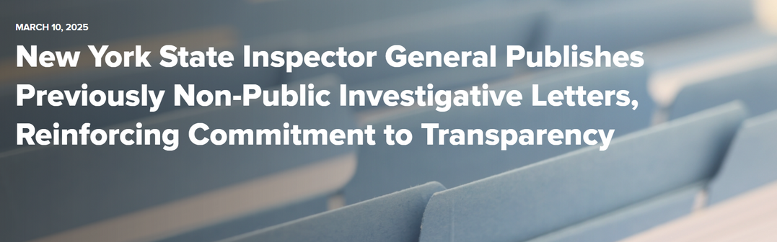
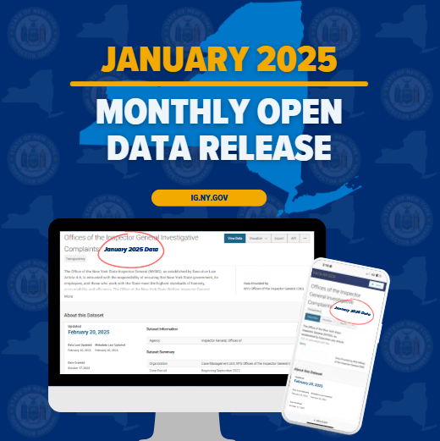



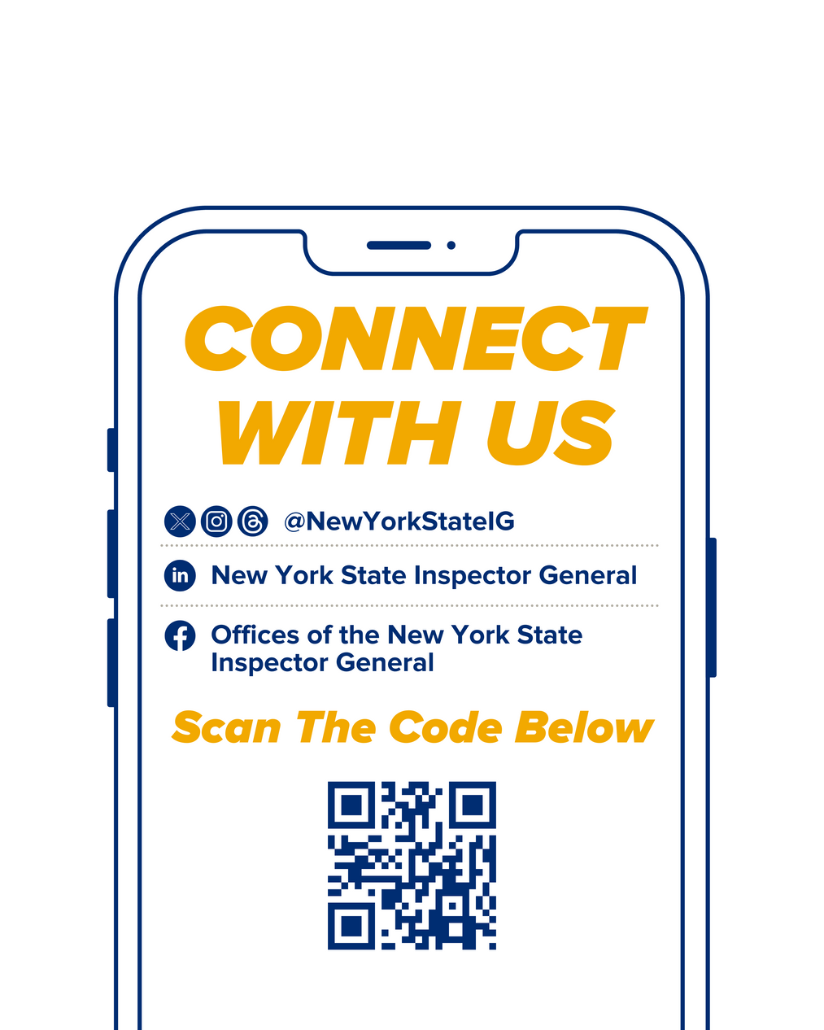
Information & Communication as Seen Within OIG
OPEN DATA
PORTAL
Integration with
publicly accessible dashboards containing anonymized data
about all complaints received by
the OIG.
Publication of current
& historical reports & letters.
By sharing investigative findings, the agency reinforces its dedication to transparency & to addressing issues promptly & responsibly, fostering a culture of integrity.
REPORTS & LETTERS
SOCIAL MEDIA
These tools will both educate the public on the actions of the office and provide another channel through which complaints may be submitted.

Slide 25

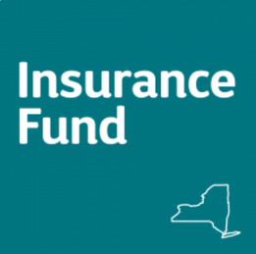





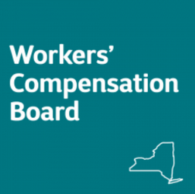
Information & Communication as Seen Within OIG
External Trainings
Internal Trainings
Dedicated section
for training resources,
workshops, & professional development opportunities.
Integration with NYS learning management systems for easy access to online courses & educational materials.
Fraud Prevention
&
Integrity Assurance

Slide 26
Monitoring
Ongoing evaluations to assess whether the five components of internal control are effectively functioning.
Monitoring
  Conducts ongoing and/or separate evaluations
Control Activities
Information & Communication
  Evaluates and communicates deficiencies
Risk Assessment
Control Environment

Slide 27
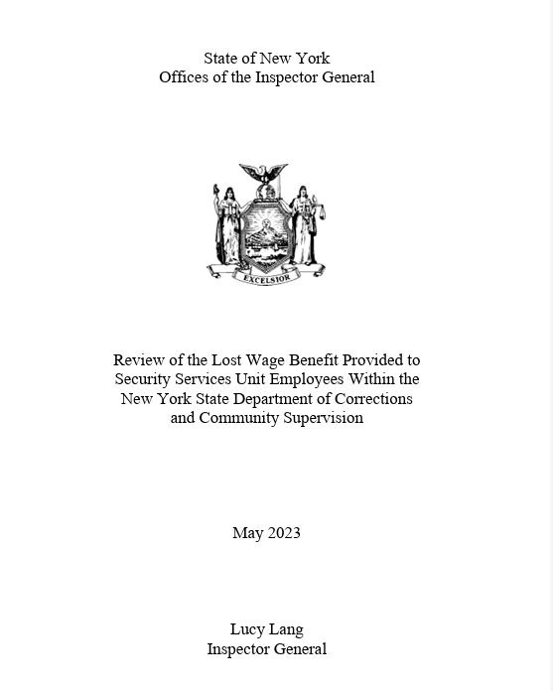
https://ig.ny.gov/news/oig-releases-report-workers-compensation-claims-doccs-0

Slide 28

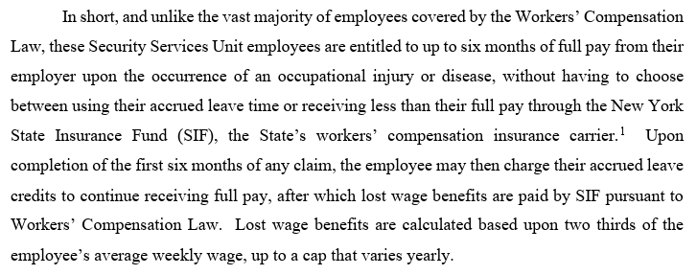
What Are Lost Wage Benefits?

Slide 29


Workers’ Comp & Internal Controls
Control Environment
Risk Assessment
Control Activities
Info & Communication
Monitoring Activities

Slide 30
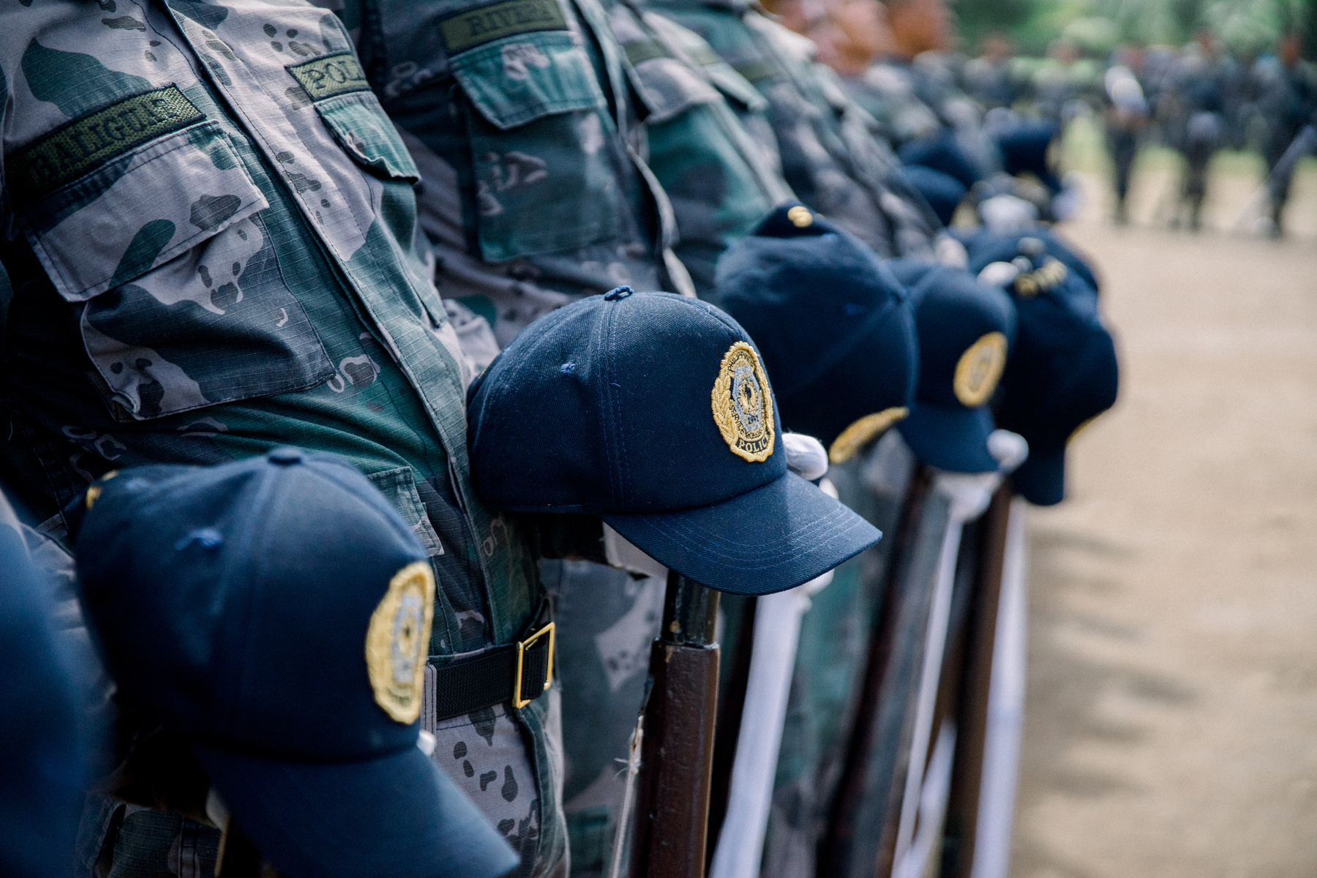
Control Environment
Training Sessions
Train newly hired recruits, sergeants, lieutenants, captains, and superintendents when they are hired/promoted to those roles. OIG provides the following information:
  An overview of our office to include our authority, jurisdiction, and what should be reported to us; and
  Information regarding Workers’ Compensation Fraud and DOCCS’ abuse of it, along with other areas focused on ethics topics, such as FMLA abuse.
Monitoring
Information & Communication
Control Activities
“See something, say something.”
Risk Assessment
Control Environment

Slide 31
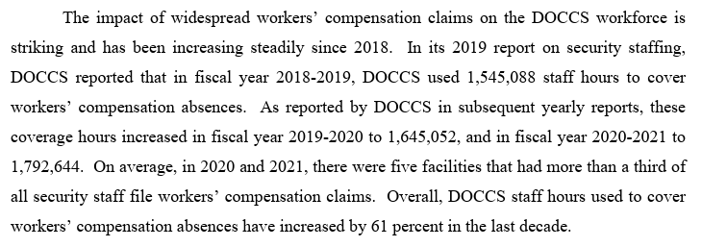
Risk Assessment
FY YEAR | Overtime Hours Due to WC Absences
2018-2019 | 1,545,088
2019-2020 | 1,645,052
2020-2021 | 1,792,644
2023 Overtime Rates:
CO = $53.80 per hour average
Sergeant= $64.86 per hour
Source: https://doccs.ny.gov/system/files/documents/2021/02/2019-security-staffing-report.pdf
Source: https://doccs.ny.gov/system/files/documents/2024/03/2023-doccs-report-of-security-staffing-final.pdf

Slide 32
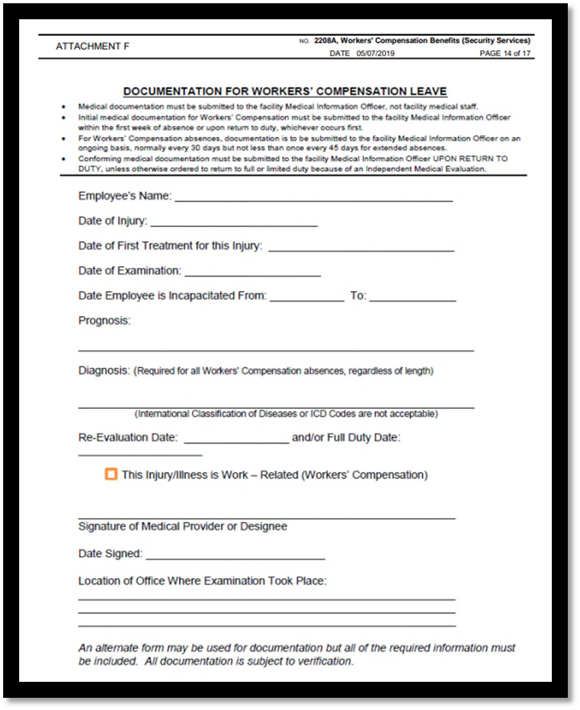
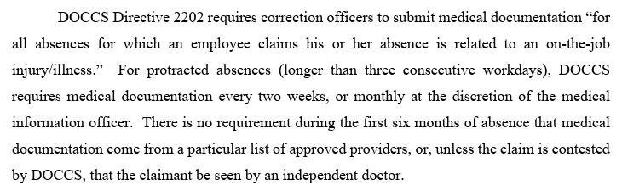
Control Activities
WC Medical Documentation

Slide 33


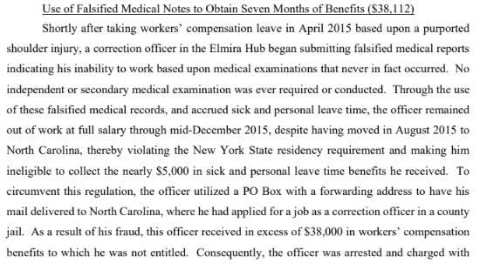
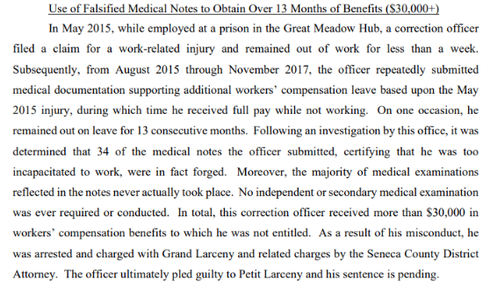
Control Activities
DOCCS WC Case Examples

Slide 34
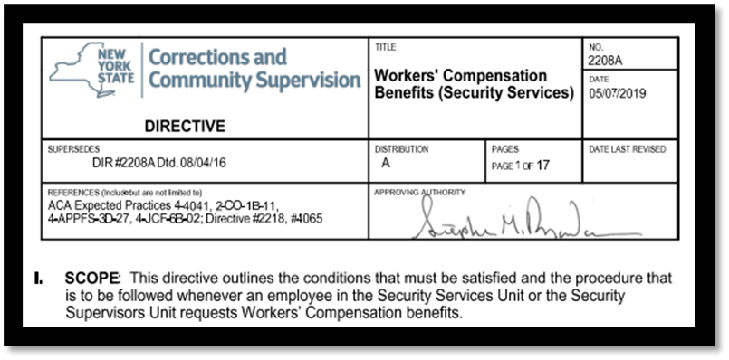
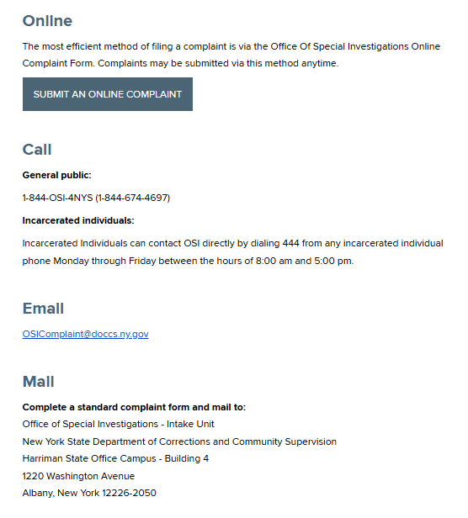
Information and Communication
Policies & Procedures
Complaint Hotlines
External Partnerships

Slide 35
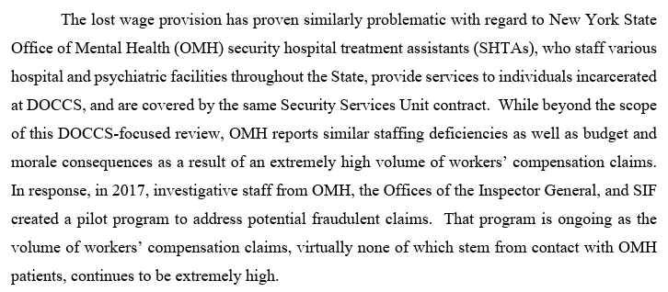
It’s Not Just A DOCCS Issue!

Slide 36


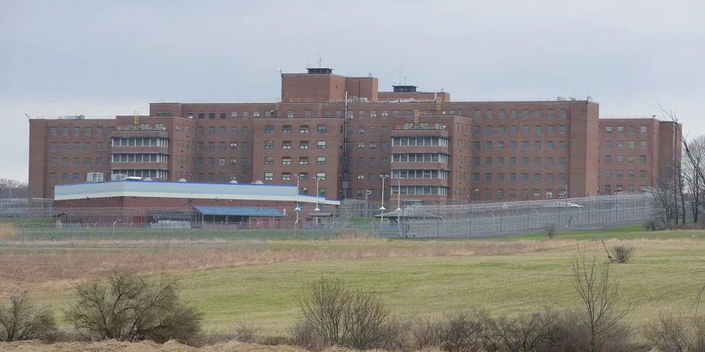
Super Bowl, Puerto Rico, and Central NY Psych?!
Source: https://kayakingpuertorico.com

Slide 37
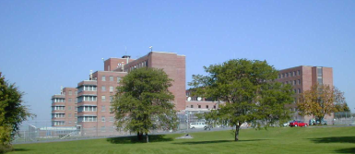

Central New York Psychiatric Center
On October 20, 2015, a Security Hospital Treatment Assistant (SHTA) was involved
in a work-related incident where he allegedly hurt his back during a patient restraint.
Two days later he was evaluated by a Workers’ Compensation Board authorized chiropractor based in Utica, NY. Although the chiropractor allegedly found the employee to be “one-hundred percent temporarily impaired”, he did not take the employee out of work at that time.

Slide 38

Let’s Get Ready for Some Football!
Fast forward 3 months...
The employee traveled to California for Super Bowl 50
between the
Denver Broncos and the Carolina Panthers.
February 4: employee and chiropractor exchanged text messages and phone calls.
February 6: employee worked as a table assistant at the Maxim Superbowl party.
February 8: employee called out sick for February 8th and 9th; and flew overnight back to New York.
February 9: chiropractor wrote the employee a note which stated the employee was “one-hundred percent impaired” from his October 2015 back injury due to “extended sitting.”
February 13: chiropractor’s note was faxed to CNYPC’s HR after the employee returned to work.

Slide 39


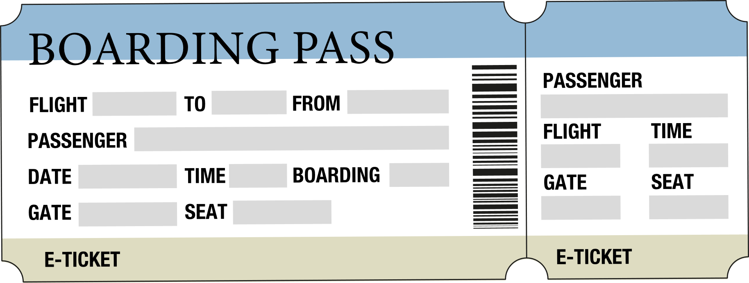

Off To Sunny Puerto Rico!
March 26: employee purchased a roundtrip airline ticket to Puerto Rico for April 4 - 11.
March 27: employee purchased a kayaking and snorkeling excursion for April 7.
March 31: the chiropractor treated the employee for his October back injury and wrote the
employee a note excusing him from work between March 31 and April 15.
April 4-11: employee vacationed in Puerto Rico, including taking an outdoor excursion.

Slide 40
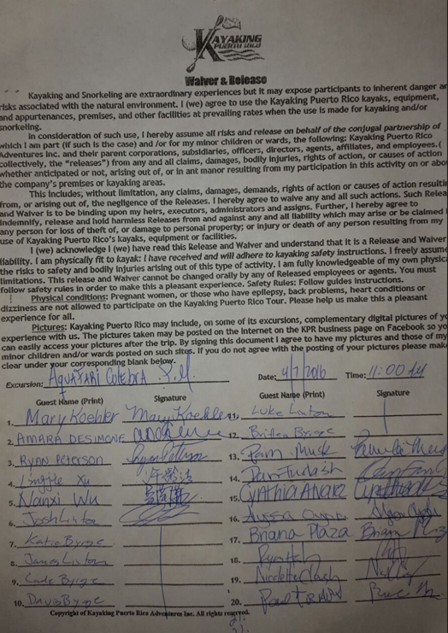






“I am physically fit to kayak...”
April 7: employee participated in the kayaking excursion and signed a waiver and release acknowledging that people with “back problems. . . are not allowed to participate”.

Slide 41

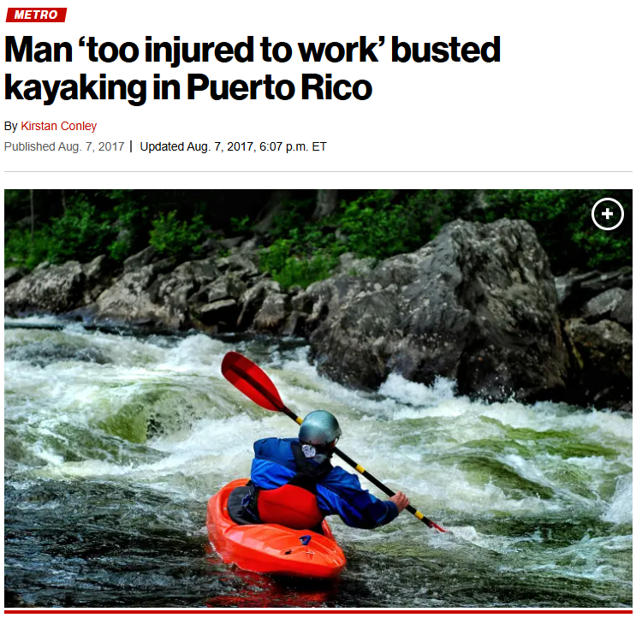
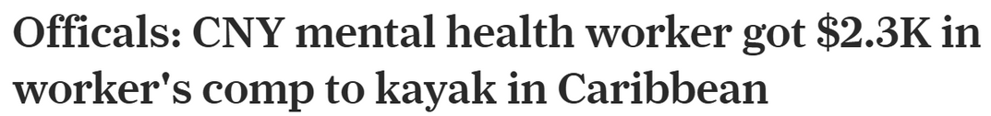

The Outcome

Slide 42




Success is Dependent Upon Us
The establishment of a system of internal controls is not enough to safeguard an agency.
Internal controls must be communicated, executed, abided by, reviewed and revised on a continual basis to have an impact.
We All Have A Role To Play!

Slide 43
Katie Q. McCutcheon
Deputy Chief Counsel
Director of Training
Katie.McCutcheon@ig.ny.gov
Website
www.ig.ny.gov
Number
Erin Bach
Confidential Investigator
Internal Controls Officer
Erin.Bach@ig.ny.gov
1-800-DO-RIGHT (1-800-367-4448)
Email
Inspector.General
@ig.ny.gov
Katherine Rizzo
Senior Investigative Auditor
Katherine.Rizzo@ig.ny.gov
Twitter/Instagram
Integrity: The Foundation of Public Service
SLMS Class Code: NYSIG-INTEGRITY
@NewYorkStateIG

